Slide 1

Coronavirus Tweet Analysis
By: Jasmine Zeng

Slide 2
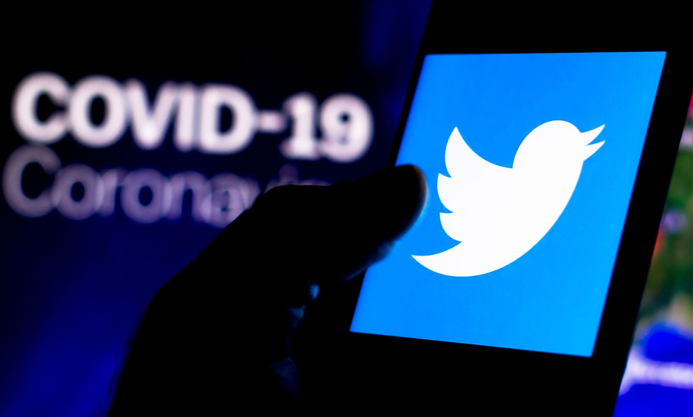
What do people discuss?
-Topic Modeling
- Tool: LSA, NMF, LDA
What is the hottest topic?
- Dynamic Topic Modeling
What are people’s attitude?
- Sentimental Analysis
- Tool (VADER)

Slide 3
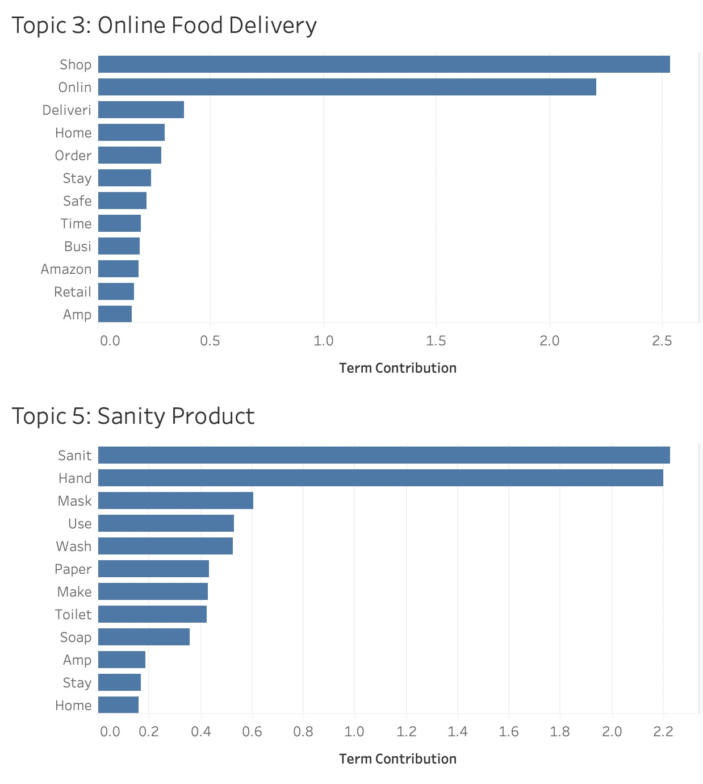
Topic Modeling
5 Topic:
Panic Food Buying
Social Distance
Online Food Delivery
Oil Price
Sanitary Product
Note: Tool used here are Porter Stemmer and NMF.

Slide 4

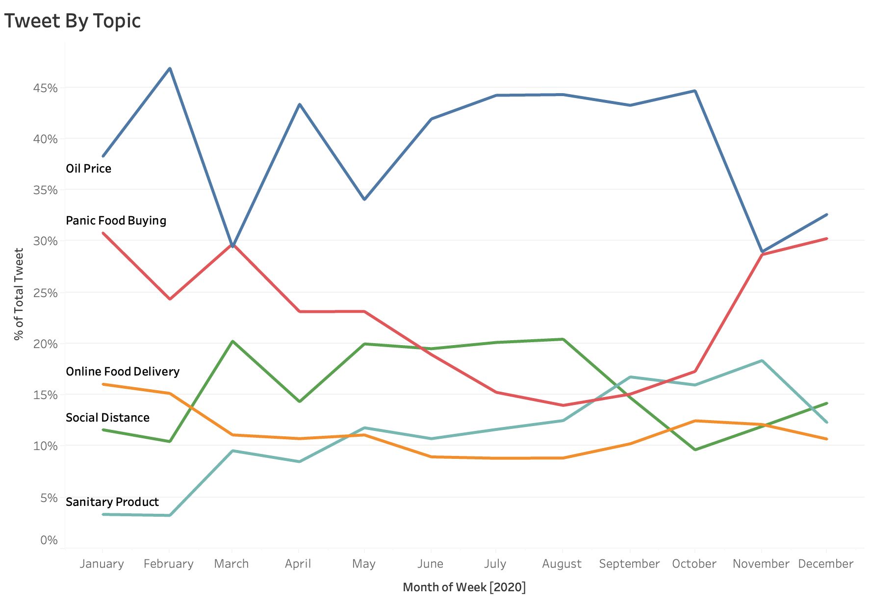
People cares about oil price a lot. Sanity Product topic gets heating up.

Slide 5
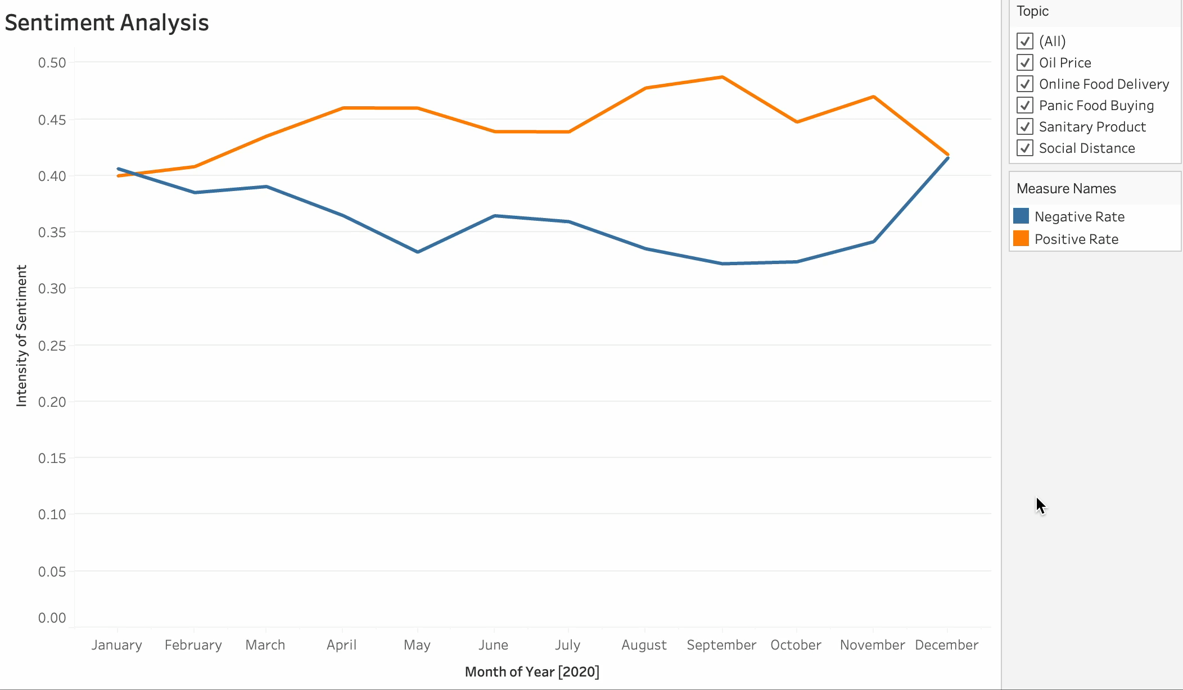
In most of the topics, we see negative feelings are coming back by the end of 2020

Slide 6

THANK YOU!

